Slide 1
Computer Vision and Image Processing
Tirgul 9
Image Pyramids and Image Blending
& Moriya Bitton

Slide 2
Gaussian pyramid
& Moriya Bitton

Slide 3
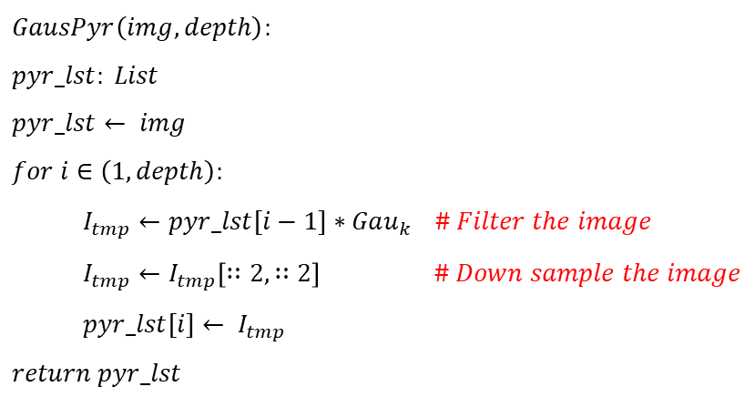
Image Pyramids
Basic pyramid: Gaussian pyramid
$$GausPyr\left(img,depth\right):$$
$$pyr_lst: List$$
$$pyr_lst← img \\ for i∈\left(1,depth\right):$$
$I_{tmp}←pyr_lst[i−1]∗Gau_{k}$ $\# Filter the image$
$$I_{tmp}←I_{tmp}\left[∷2,∷2\right] \# Down sample the image$$
$$pyr_lst[i]← I_{tmp}$$
$$return pyr_lst$$

Slide 4
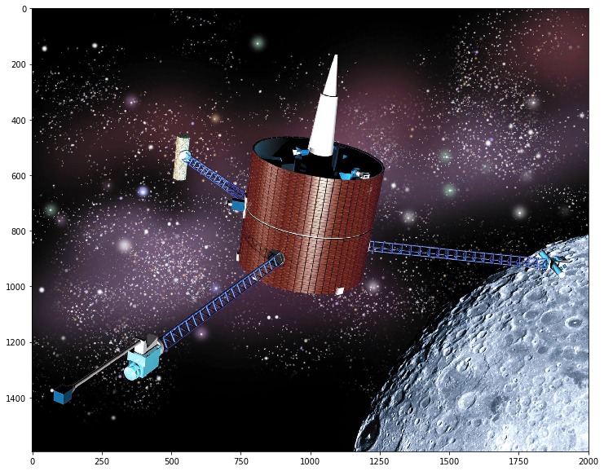
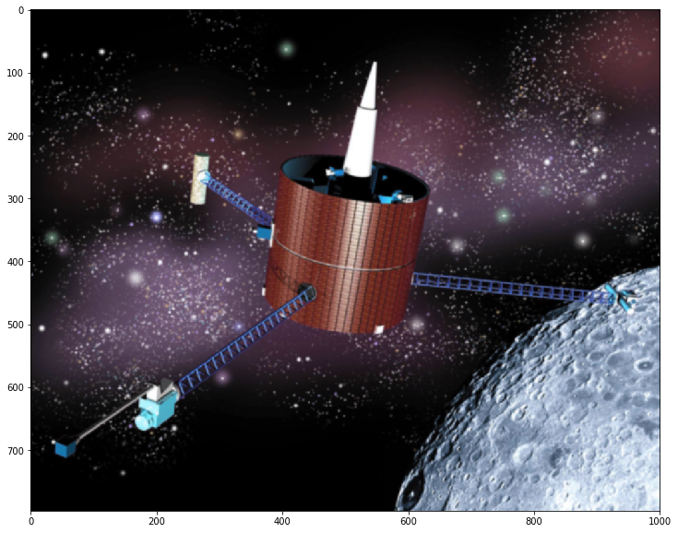
Step 1

Slide 5
Step 2

Slide 6
Step 3

Slide 7
Step 4

Slide 8
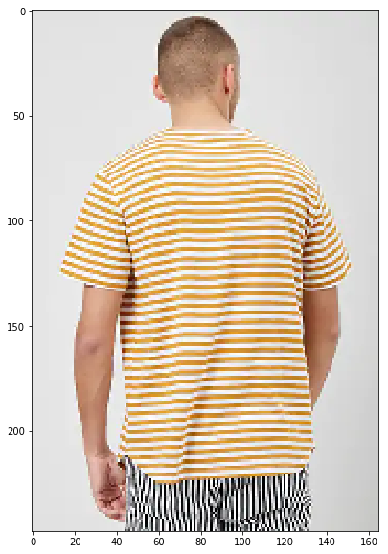
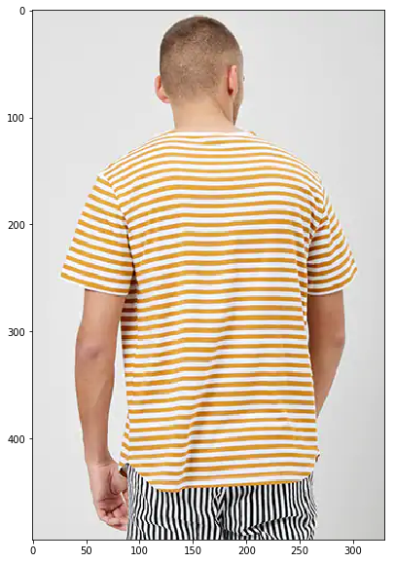
Why do we blur the image?
Img[::2,::2]
Anti-Aliasing!

Slide 9
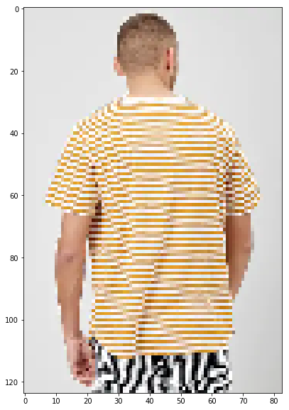
Anti-Aliasing!
Another down sample and
look at the pants..

Slide 10
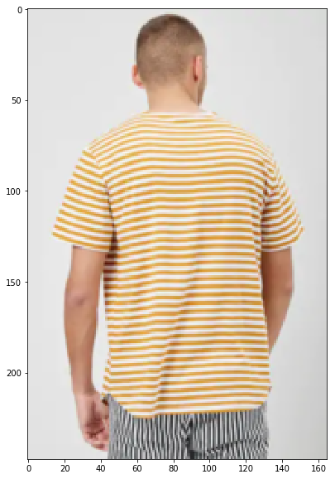
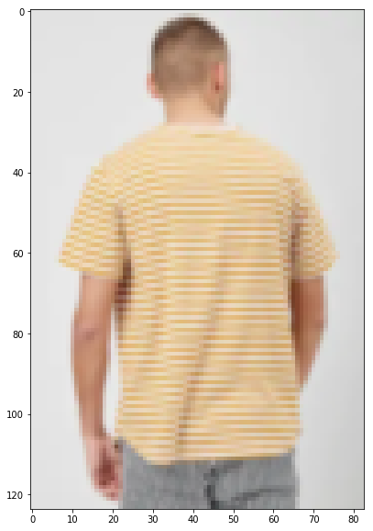
Now with blurring first
X2
X4

Slide 11
How does blurring help?
Theory: When you downsample an image, you take every 2nd pixel.
This can create sharp “jumps” in the higher frequencies.
Blurring helps suppress them from being passed to the smaller image and damaging the image.

Slide 12
How does blurring help?
1
5
10
8
3
1
10
3
.5
.5
1
5
10
8
3
1
3
7.5
9
5.5
1
7.5
5.5

Slide 13
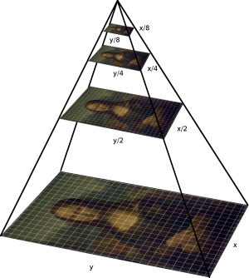
Gaussian Pyramid
Used for multi-scale edge estimation.
Efficient to compute coarse scale images. The same filter is used to computer all the levels.
Highly redundant, coarse scales provide much of the information in the finer scales.

Slide 14
Laplacian pyramid
& Moriya Bitton

Slide 15
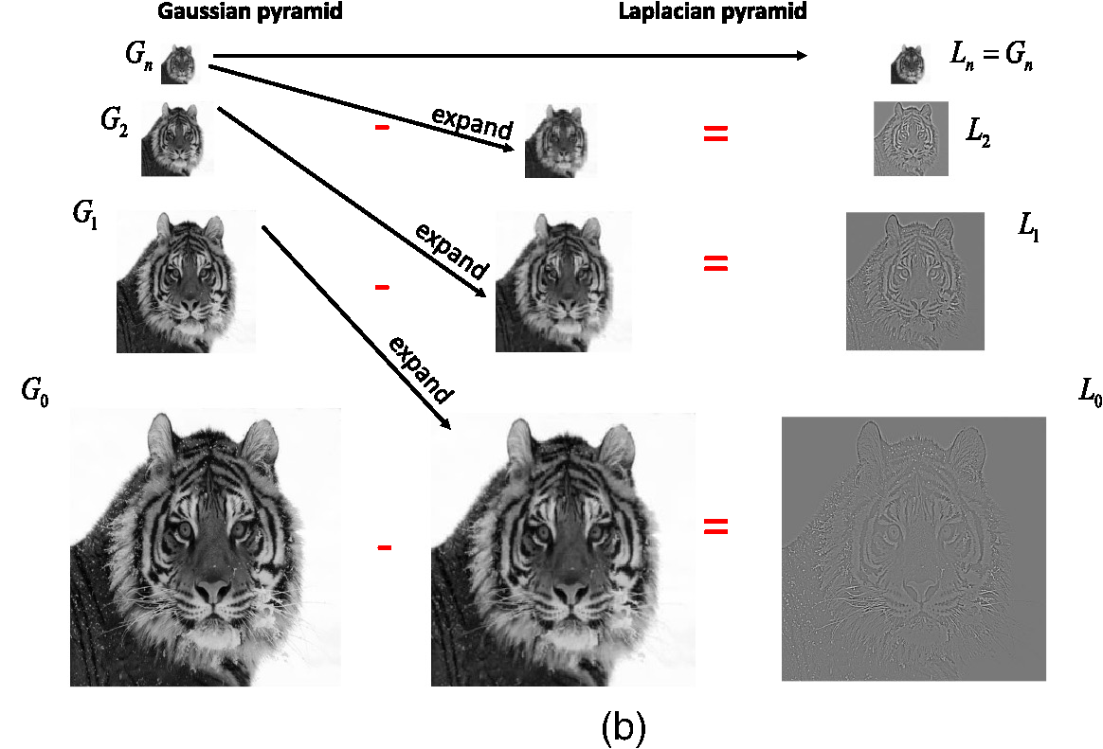
Laplacian Pyramid

Slide 16
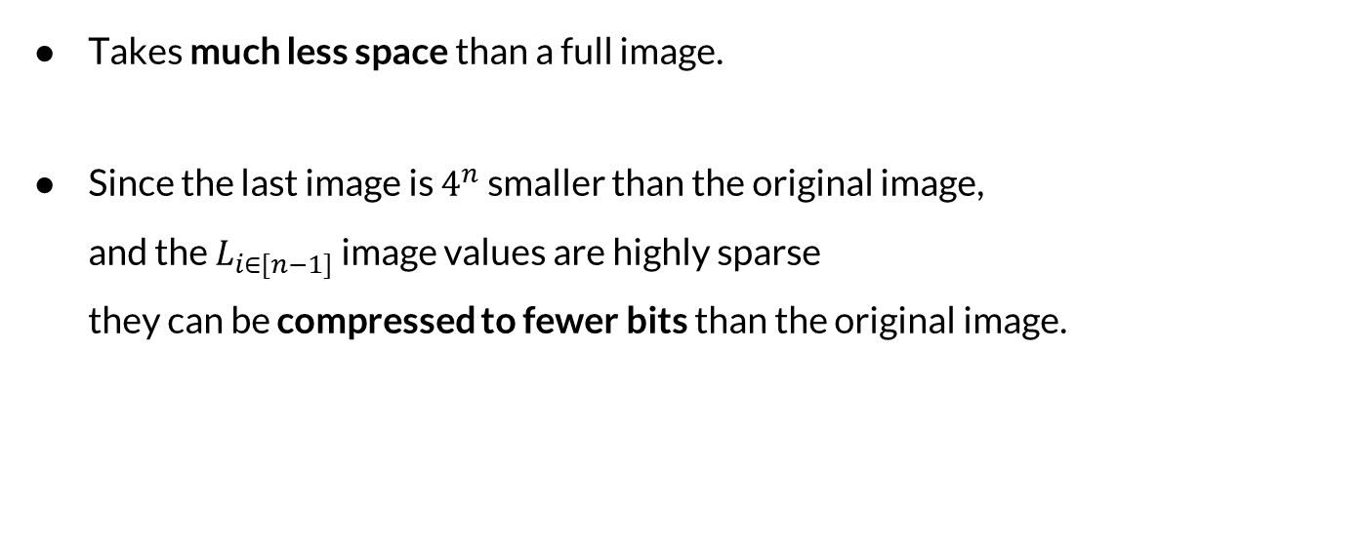
Laplacian Pyramid
Takes much less space than a full image.
Since the last image is $4^{n}$ smaller than the original image, and the $L_{i∈[n−1]}$ image values are highly sparse they can be compressed to fewer bits than the original image.

Slide 17
Image Blending
& Moriya Bitton

Slide 18
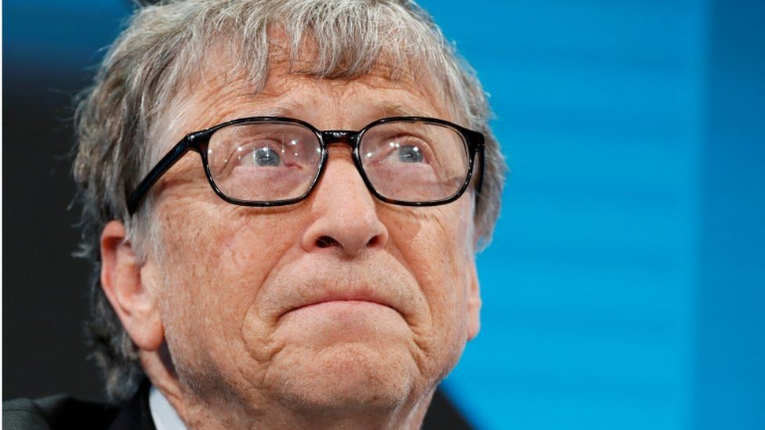


Blending

Slide 19
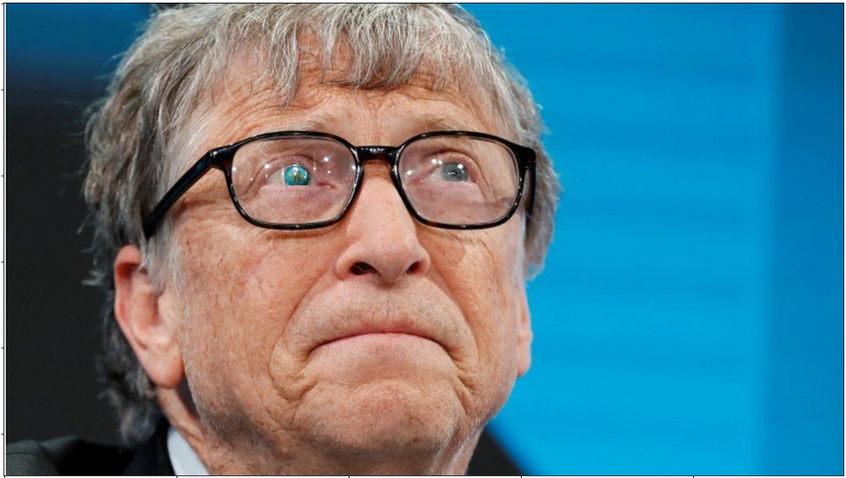
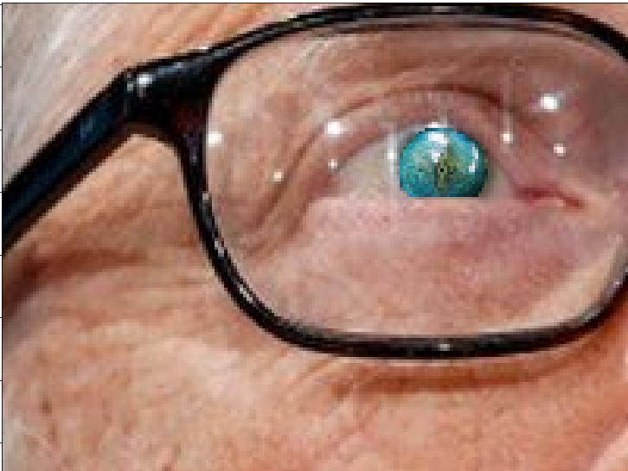
Blending

Slide 20
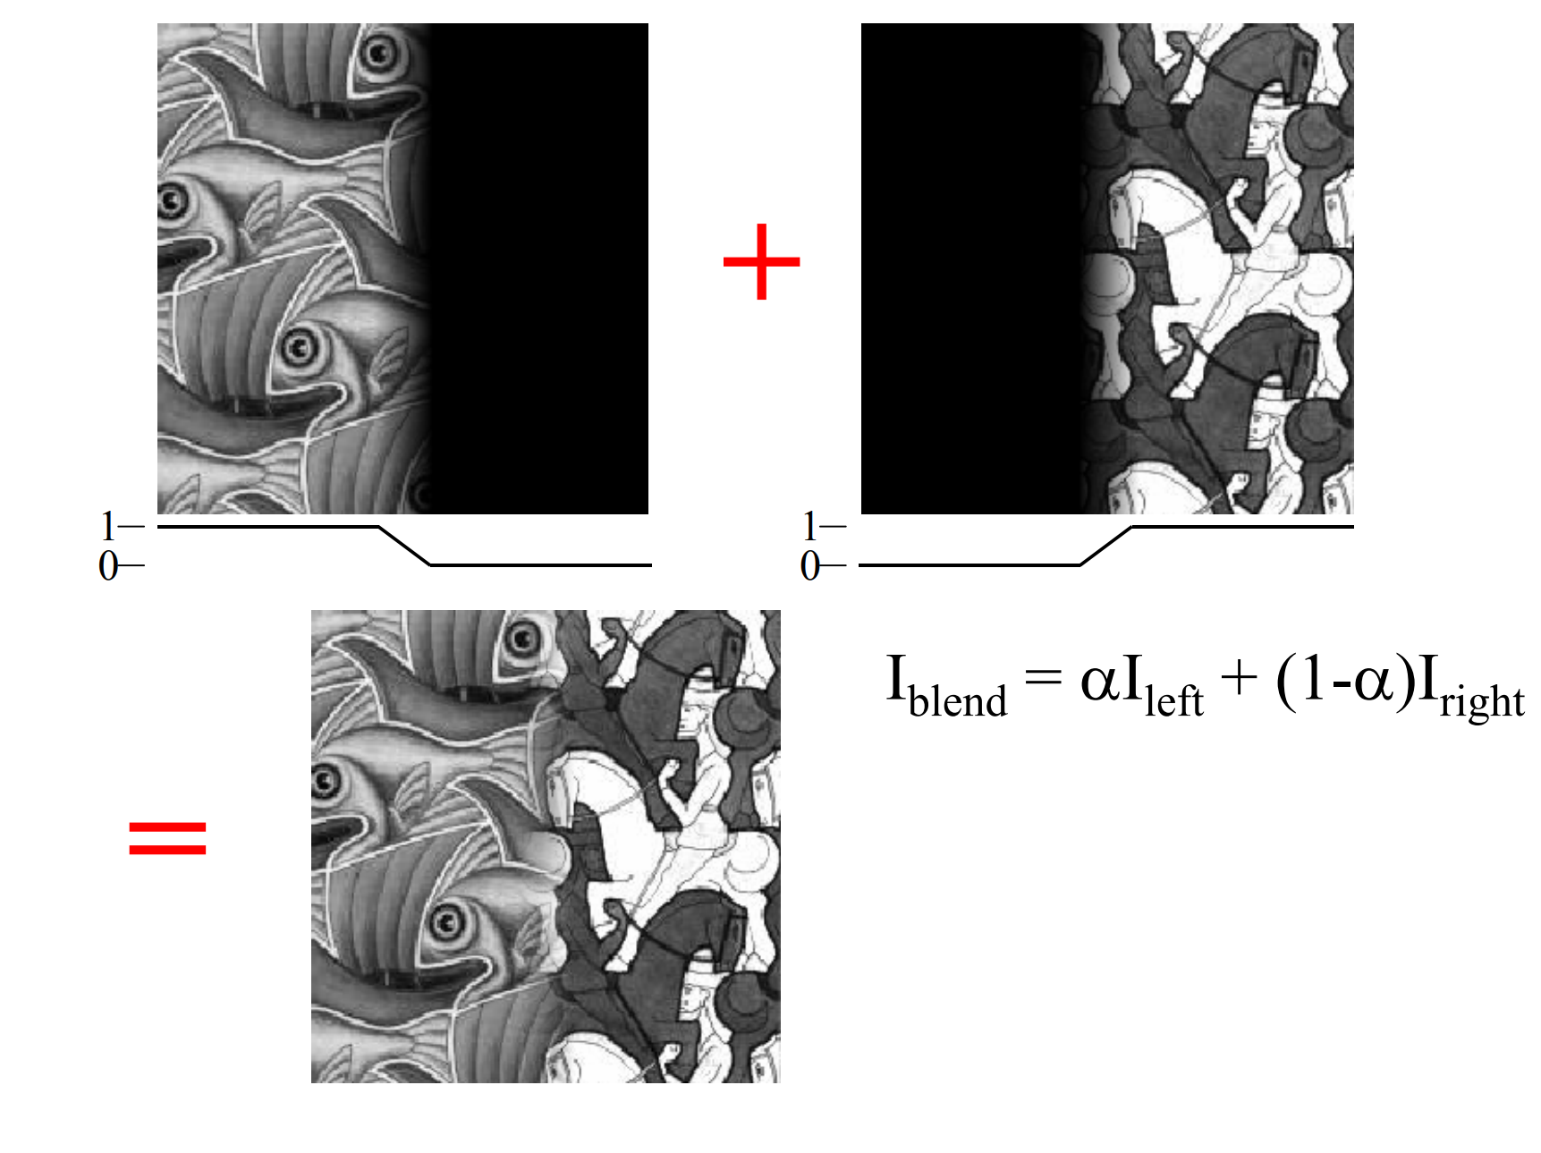
Alpha feathering

Slide 21

Alpha feathering
Gaussian blur

Slide 22
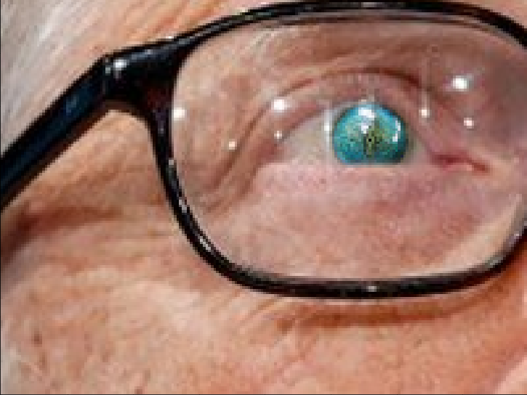
Alpha feathering
Mask crop
Alpha Feathering

Slide 23
Alpha feathering
Better than regular blending but not perfect.
Needs a lot of trial & error until you get the right function to blur the mask.
No ‘One Size Fits All’.

Slide 24
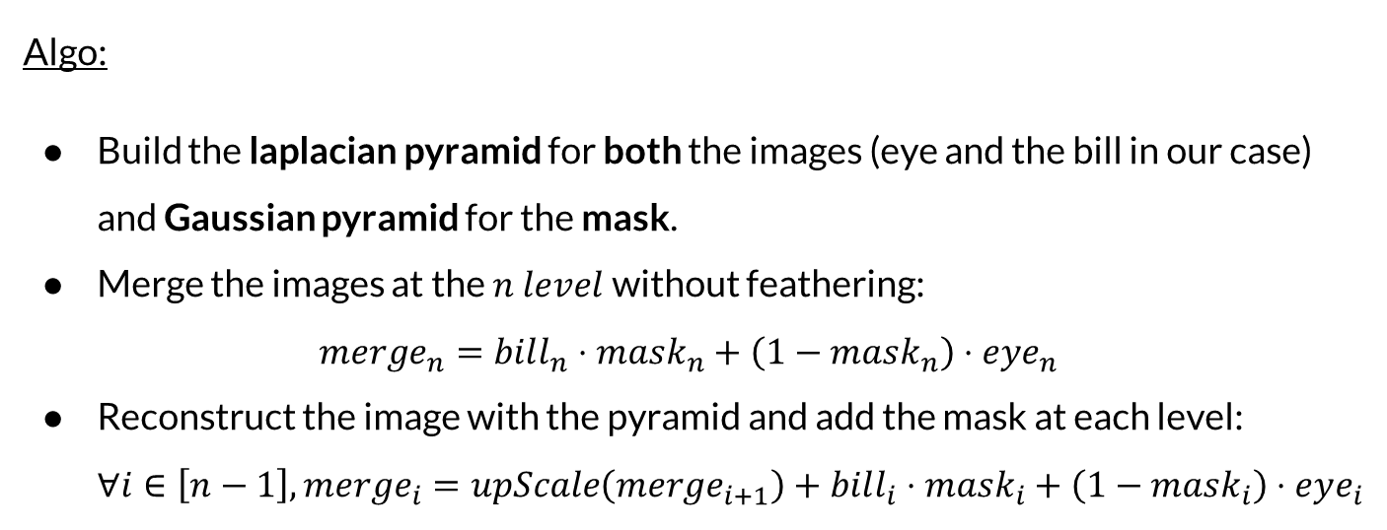
Pyramid Blending
Algo:
Build the laplacian pyramid for both the images (eye and the bill in our case) and Gaussian pyramid for the mask.
Merge the images at the $n level$without feathering: $merge_{n}=bill_{n}⋅mask_{n}+\left(1−mask_{n}\right)⋅eye_{n}$
Reconstruct the image with the pyramid and add the mask at each level: $∀i∈\left[n−1\right],merge_{i}=upScale\left(merge_{i+1}\right)+bill_{i}⋅mask_{i}+\left(1−mask_{i}\right)⋅eye_{i}$

Slide 25
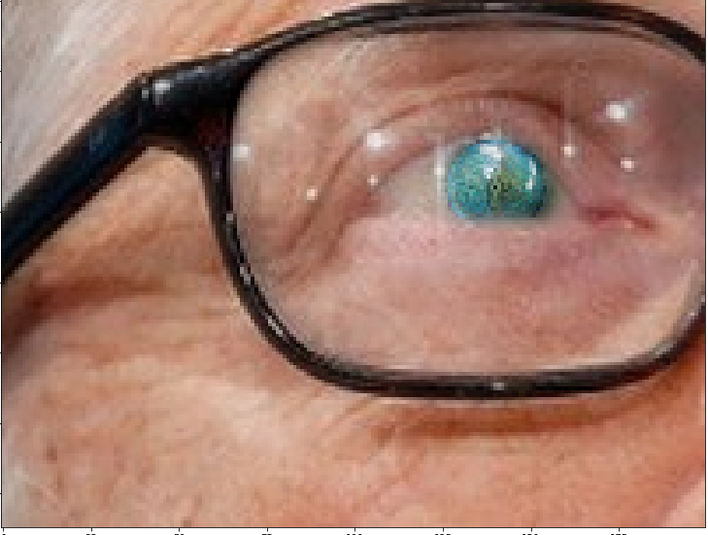
Mask crop
Alpha Feathering
Pyramid Blending

Slide 26
Pyramid Blending
Easier to use than alpha blending.
No need for complicated tuning.
‘Thin’ objects will disappear if the pyramid depth is too deep.

